Slide 1

IcUB and R1 Hardware and infrastructure
by the IT point of view

Slide 2
What are we going to see?
Hardware components
Networking
Software components

Slide 3
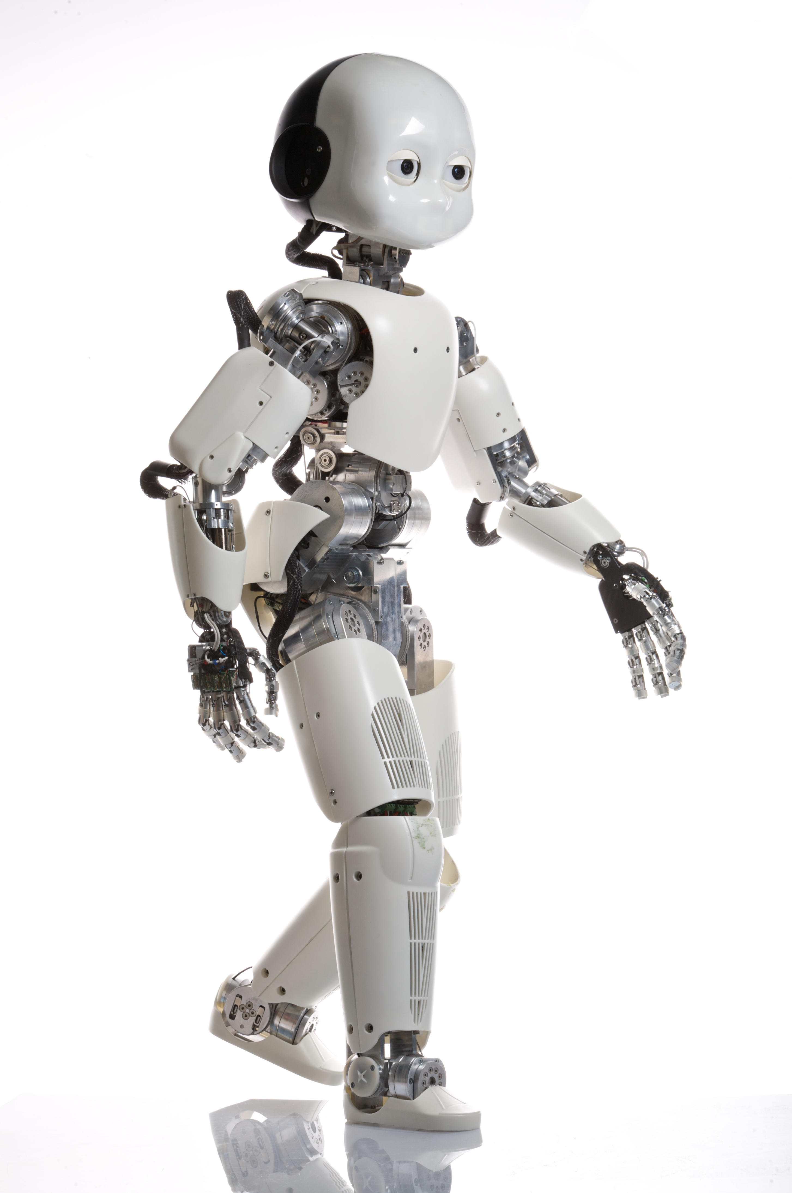
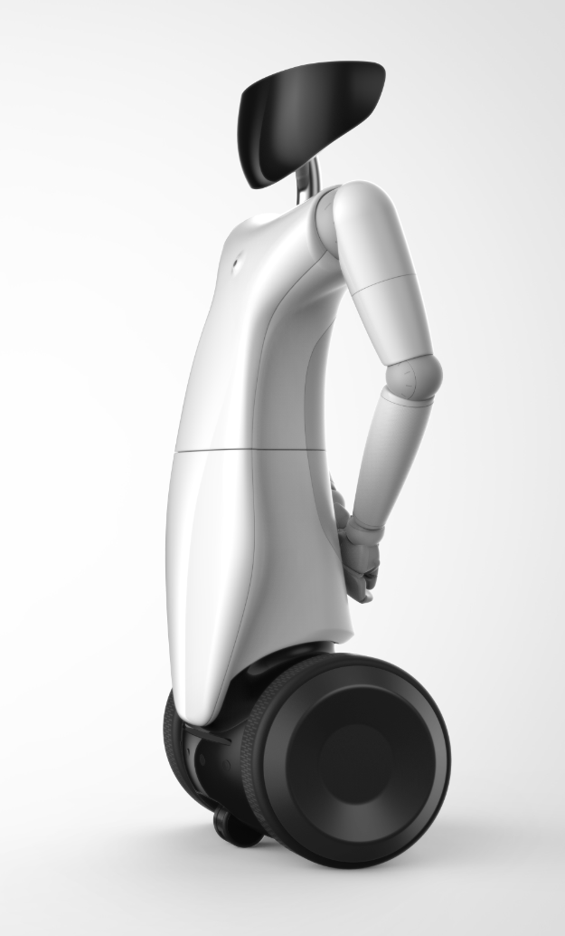
Which robotic setups?
iCub (black, purple, green, iCub3)
R1 (mk1 and mk2)

Slide 4


iCub Setup
iCub Hardware components 1/4
There is not a standard for components, each setup is different
The same component (i.e. wifi router) can be different in vendor and model among setups
Setups are not steady, components change to follow new needing (it’s research, baby!)
Changes in HW components may requires changes in SW configuration
So, instead of describing each setup in detail, we’ll see an the «ideal» setup (iCub3) and we’ll describe hardware components generally

Slide 5
The past
iCub Hardware components 2/4

Slide 6
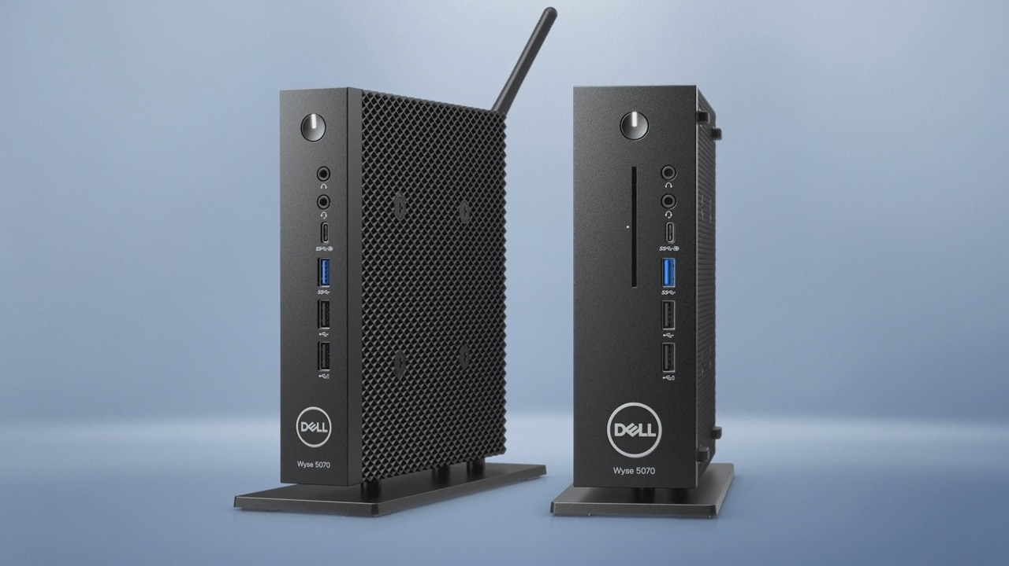
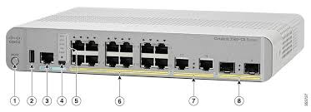
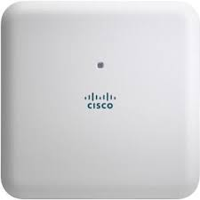
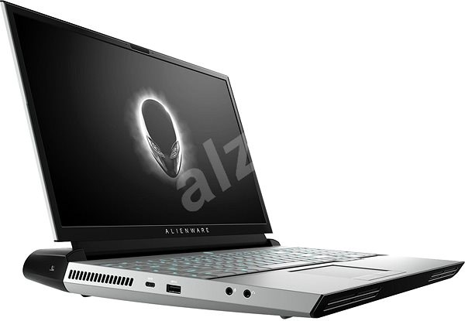
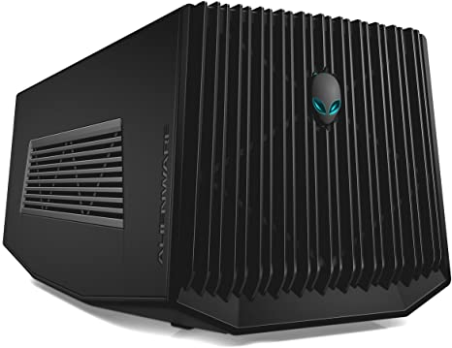
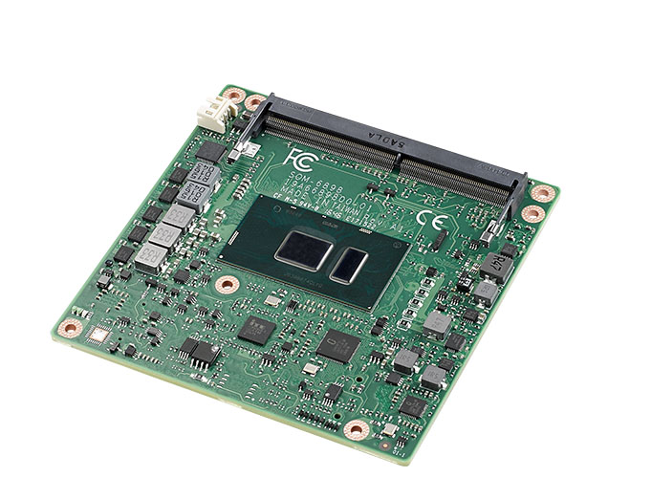
The future – iCub3
iCub Hardware components 3/4
Designed to be portable:
Small desktop server
Small desktop network switch
Wifi router (similar to IIT wifi infrastructure)
Powerfull laptop PCs with CUDA-capable GPU
CUDA box (to be attached to laptops)
iCub head: COMexpress embedded PC with ssd Hard Drive, WiFi and Bluetooth

Slide 7
The present – other setup
iCub Hardware components 4/4
Black iCub
Purple iCub
Green iCub
7U rack with power supply and network switch (rack model)
Small desktop server
New GPU-equipped Alienware laptop
CUDA workstation
iCub head – PC104 diskless (OS on USB)
7U rack with power supply, network switch (rack model) and main server (rack model), CUDA workstation (rack mounted)
Old model laptops
iCub head – COMexpress with SSD disk and WiFi
7U rack with power supply, network switch (rack model) and main server (rack model)
Old model laptops and new GPU-equipped Alienware
Cuda Workstation
Wifi router
iCub head – COMexpress with SSD disk, Bluetooth and WiFi

Slide 8

R1 Setup
R1 Hardware components 1/
There are only 2 versions: old (mk1) and new (mk2), with small differences in HW components (the bigger changes are in mechanics)
Usually, new hardware is added to the newer setup (mk2)
The situation is more stable than iCub setup and the we’ll see in details newer version.

Slide 9
R1 MK2 – on board
R1 Hardware components 2/
The face PC – an ARM based embedded PC with OS (Ubuntu) running on SD card that controls face display
The torso PCs – two ARM based embedded PC with OS (Ubuntu) on internal memory and a CUDA-capable GPU
The base PC – an X86 based embedded PC with OS (Ubuntu) running on SSD drive (PCI-X)
Networking – embedded wifi media coverted with 4 ports switch, it can operate in 2 different modes (standalone and client)

Slide 10
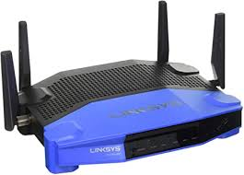
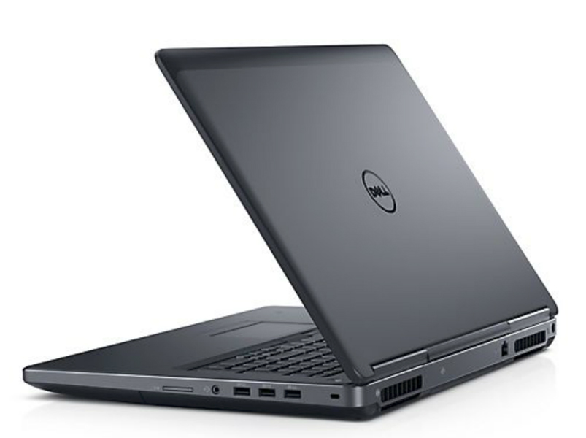
R1 MK2 – external components
R1 Hardware components 3/4
Designed to be portable:
Small desktop network router with wifi
Laptop PCs
Powerful laptop PCs with CUDA-capable GPU
CUDA box (to be attached to laptops)

Slide 11
R1 MK1 – differences
R1 Hardware components 4/4
Less hardware:
On board - Single embedded PCs in the robot torso
NO laptop PCs with CUDA-capable GPU
NO CUDA box

Slide 12

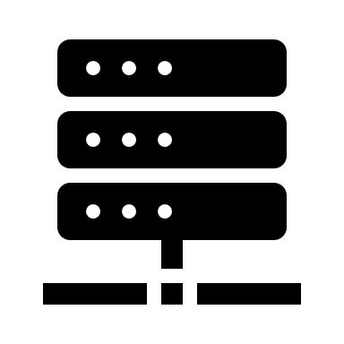




iCub and R1 networking
Physical connections
Logical connections
Sockets and cables
Protocols and routing

Slide 13


iCub Physical connections
iCub Networking 1/4
There are small but important differences among setups, here we describe the general principles, a «live» tour of setups will explain details and differences.
There are two operative modes:
Home
Abroad
Uses the IIT networking infrastructure and desk sockets
Uses the setup networking infrastructure and (long) cables

Slide 14

Home operative mode
iCub Networking 2/4
This mode uses the IIT networking infrastructure (switches, wifi) to connect robot components, which have to be connected to network socket on the desks
7
The INTERNAL socket must be connected to an Robot VLAN socket on desks
front
U ack
–
«Power»
Virtual Server
–
running vmWare ESX
(
1
U
•
Nork Switch
24
ports
)
(
1
U
•
12
V Power Supply
)
(
2
U
•
40
V Power supply
)
(
2
U
•
)
Rack Network plugs
(
1
U
)
The EXTERNAL socket must be connected to a normal socket on desks
Rack network plugs
back

Slide 15
Abroad operative mode
iCub Networking 3/4
This mode uses the setup switch (switches, wifi) to connect robot components, it is used while travelling
7
The INTERNAL socket must be connected to a posrt on the Robot switch
front
U ack
–
«Power»
Virtual Server
–
running vmWare ESX
(
1
U
•
Nork Switch
24
ports
)
(
1
U
•
12
V Power Supply
)
(
2
U
•
40
V Power supply
)
(
2
U
•
)
Rack Network plugs
(
1
U
)
The EXTERNAL socket must be connected to a normal socket (internet connected)
Rack network plugs
back

Slide 16





iCub Logical network connections
iCub Networking 4/4
iCub private subnet 10.0.0.0/24
wifi
Internet
robot
iCub server
switch
laptops
Internal (10.0.0.1)
External (DHCP)
The iCub server is the default GATEWAY for the robot private subnet.
If its external connection is not active there is no internet connection.
workstations

Slide 17


R1 Physical connections
R1 Networking 1/2
There are no differences between old and new setup, but the robot can work in 2 different modes:
Client (normal)
Standalone
The wifi infrastructure is provided by the wifi router and if the router which also works as gateway to internet. The robot connect to the wifi using onboard wifi, which acts as a client.
The wifi infrastructure is provided by robot onboard switch. There is no internet connection, you can connect to robot machines only by connecting to its wifi. The wifi router must be switched off
With a switch on the robot you can change operative mode (when robot is off)

Slide 18
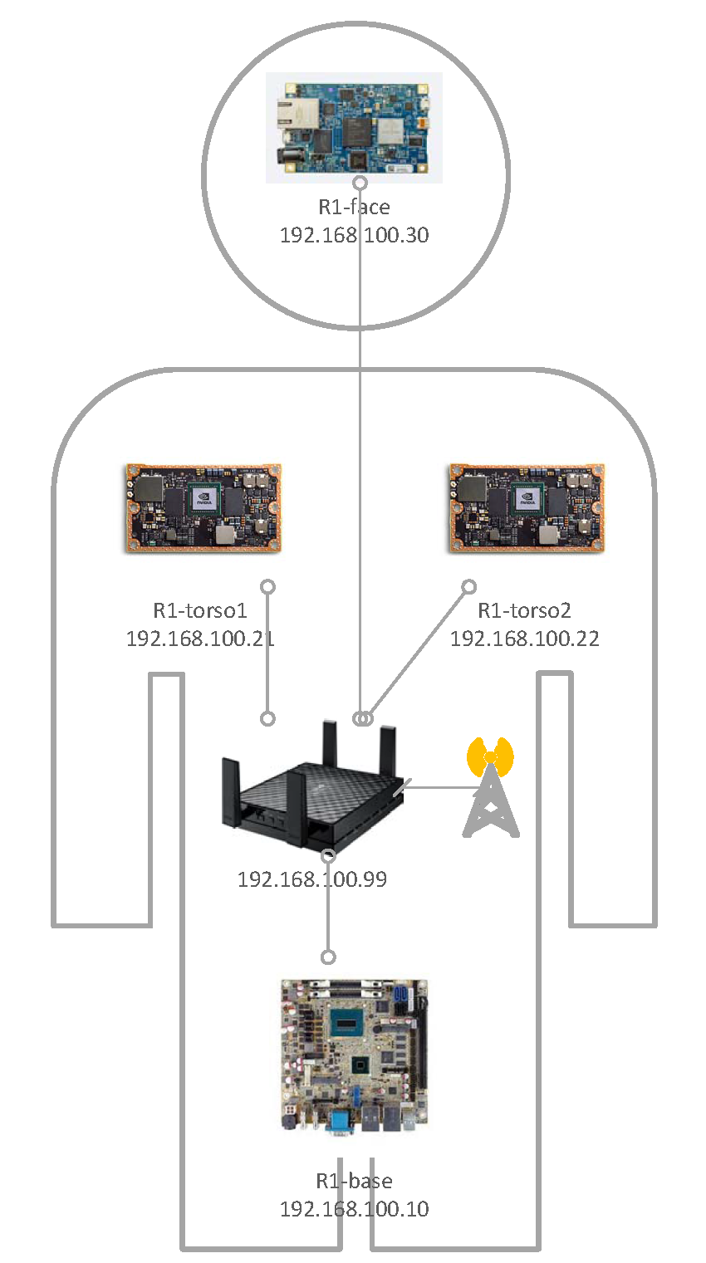
R1 Network connections
R1 Networking 2/2
Laptop (wifi)
R1 private subnet 192.168.100.0/24
Internet
robot (wifi)
Wifi router
Laptop (cabled)
WAN (DHCP)
192.168.100.1

Slide 19
iCub Software components
wifi-equipped robots (all but Blacky) does not mount anymore the NFS repository for code and local_yarp. They have their own copy of code and .local/yarp in the internal HD, this beacuse NFS can be severely harm by the (potential) instability of wifi connection

Slide 20
R1 Software components
DHCP Server
Start IP address : 192.168.100.100
Maximim number of users : 150
Client lease time : 1440 sec
R1 wifi Router
192.168.100.1
Subnet GATEWAY
DHCP server
DNS
NTP server
SSID : r1_SERIAL-wifi (where SERIAL is robot serial number, eg. for robot #001 is r1_001-wifi)
DNS Server
r1-base 192.168.100.10
r1-torso1 192.168.100.21
r1-torso2 192.168.100.22
r1-face 192.168.100.30
R1 onboard wireless Access Point - CLIENT
192.168.100.99
R1 onboard wireless Access Point - STANDALONE
192.168.100.99
NO internet connection
NO DHCP server (use only static IP on clients)
NO DNS
NO server
SSID : r1_SERIAL-wifi (where SERIAL is robot serial number, eg. for robot #001 is r1_001-wifi)
Connect as a client to the Router wifi infrastructure

Slide 21
See also..
Further details can be found on:
Setup system configurations repository on Github[1]
Robotology Redmine Knowledge Base[2]
iCub tech internal wiki[3]
iCub project wiki[4]
[1] https://github.com/icub-tech-iit/setup-system-configurations
[2] https://redmine.robotology.eu/easy_knowledge_globals
[3] https://wiki.icub.iit.local/index.php/ICub_setup_enviroment
[4] https://wiki.icub.org

